Slide 1



Kaggle Winner Presentation Template
Presentation Author
Notes:
Recommending picking out he most interesting and important parts from your documentation.

Slide 2
Agenda

Slide 3
Agenda
Background
Model
Training methods
Important findings

Slide 4
Background

Slide 5

Background
Bachelor's Degree in Applied Physics
Master's Degree in Optical Engineering
Computer Vision Engineer

Slide 6
Summary
Feeding a bsx4xHxW input to the 2D-CNN produce worse result than the one-image method. I start to think why?

Slide 7
Summary
Raw signal model
Spectrum based model
Hybrid

Slide 8
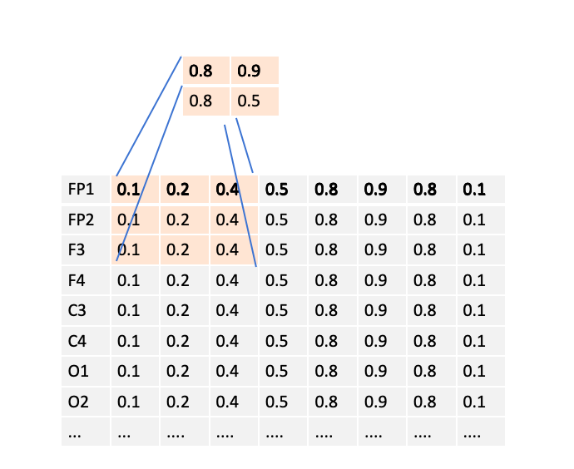
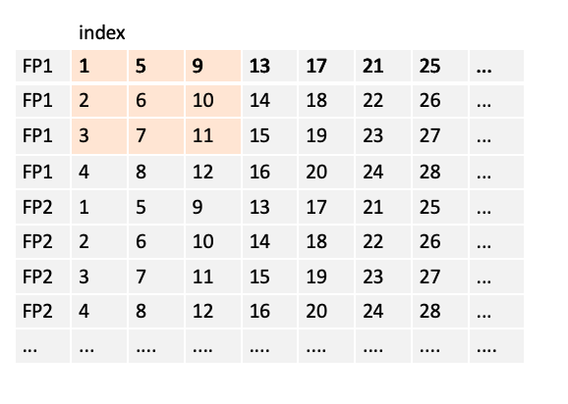
Summary
RAW eeg model

Slide 9
Summary
RAW eeg model
With efficinetnetb5,
public lb 0.230
private lb 0.282

Slide 10
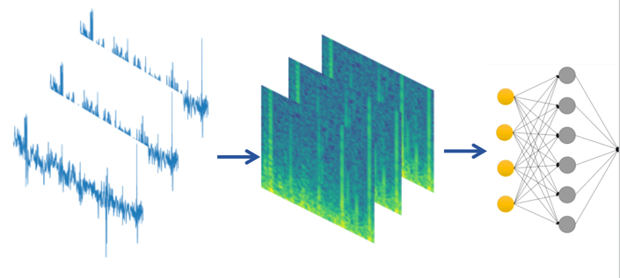
Summary
3d spectrum model
X3d-l cv 0.21+
public lb 0.25
private lb 0.29.

Slide 11
Summary
oneimage spectrum model
efficientnetb5,
public lb 0.26
private lb0.30.
combine these two spectrum model, get 0.28 private lb.

Slide 12
Summary
hybrid model
public lb 0.24,
private lb 0.29 ? ? not sure

Slide 13
Ensemble

Slide 14
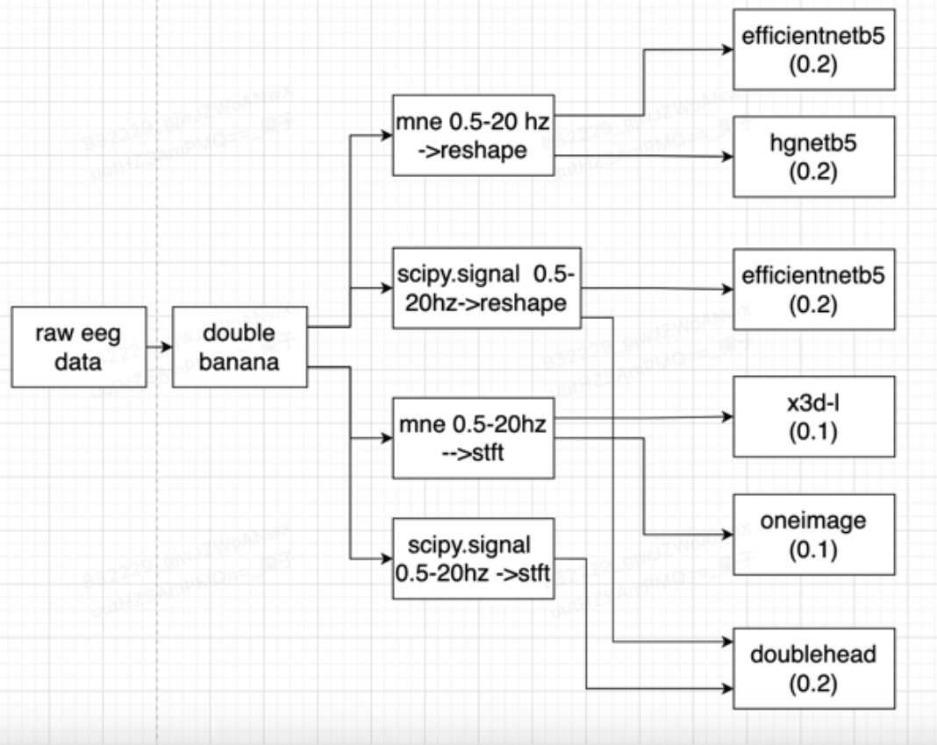
Summary

Slide 15
Training Methods

Slide 16
Training Methods
preprocess
Double banana montage, eeg as 16x10000
Filter with 0.5-20hz
Clip by +-1024
Kaggle Winner Presentation Template

Slide 17
Training Methods
trainning
Stage1, 15 epochs, with loss weight voters_num/20, Adamw lr=0.001, cos scheduel
Stage2, 5 epoch, loss weight=1for voters_num>=6 ,weight=0 for num<6, Adamw lr=0.0001, cos scheduel
use eeg_label_offset_seconds. I random choose an offset for each eegid, and the target is average according to eegid for each train iter.
Augmentation, mirror eeg, flip between left brain data and right brain data.
10 folds, then move 1000 samples from val to train, left 709 samples in val set. And use vote_num>=6 to do validation.
Kaggle Winner Presentation Template

Slide 18
Training Methods
Things tried but not work
other type of lead
raw signal without any process
different filter, for example, 0-70hz, 0.5-40hz
use gradient as feature t-t0, t-t1
Kaggle Winner Presentation Template

Slide 19
Question and Answer

